Slide 1
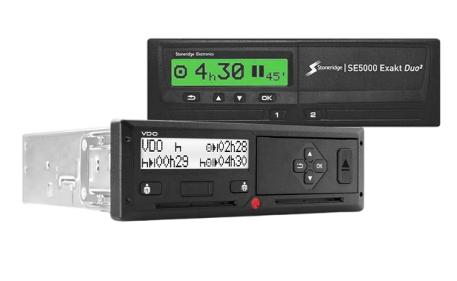
Remote download
Supported tachographs
How to find OUT

Slide 2
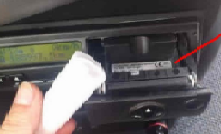
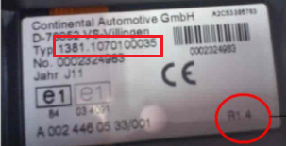
Tachograph vdo/continental
Remote downloading is supported from version 1.3a (in operation since the end of 2009)
However, there are exceptions where even versions 1.3a or 1.4 do not support this feature
Can be identified by serial number see: Overview of supported tachographs up to DTCO 3.0
The column „CAN2 (2.1 ->)“ is important and applies:
● Service compatible
○ Service activation is required for compatibility
─ Service is not compatible
The version of the tachograph and its SN can be found on the label under the printer paper roll:
The new generation of tachographs - SMART DTCO 4.0 are all compatible (but must be set to publish data – YES)

Slide 3
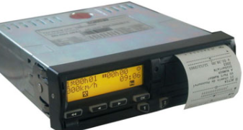
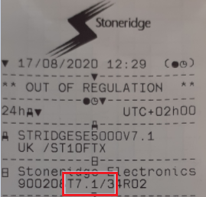
Tachograph Stoneridge
Remote downloading is supported from SE5000 7.1
The version can be found on the printout from the tachograph, see:
The new generation of tachographs (referred to as GEN 2) are all compatible
Tachographs STONERIDGE must also have „CAN Download“ activated, see below for procedure:
1. Insert the workshop card into the tachograph
2. Use the up-down buttons to select "Settings" and press "OK"
3. Go to "Parameters" and press "OK"
4. Go to "Select CAN Download" and press "OK"
5. Make sure the service is active
For Stoneridge tachographs, if the data from D8 (AETR) is not read, the correct protocol must be activated:
Insert company card
Use the buttons to select "Settings" and press "OK„
Go to "Parameters" and press "OK„
Select "Data format D8" and press "OK„
a. Set SRE in case of tachograph version up to ≤ 7.1
b. Set 2400 in case of tachograph version up to > 7.1

